Slide 1
Gradients & Regression

Slide 2
A system of linear equations
Can also be written as
Or as:

Slide 3
To solve, invert the matrix
Inverse might not exist
System can be
under-determined (infinite set of solutions)
Or over determined (no solution).

Slide 4
Approximately solving over-determined systems
How to find the minimum?
In one dimensional problem: set derivative to zero.
In multi-dimensional case, set gradient to zero.

Slide 5
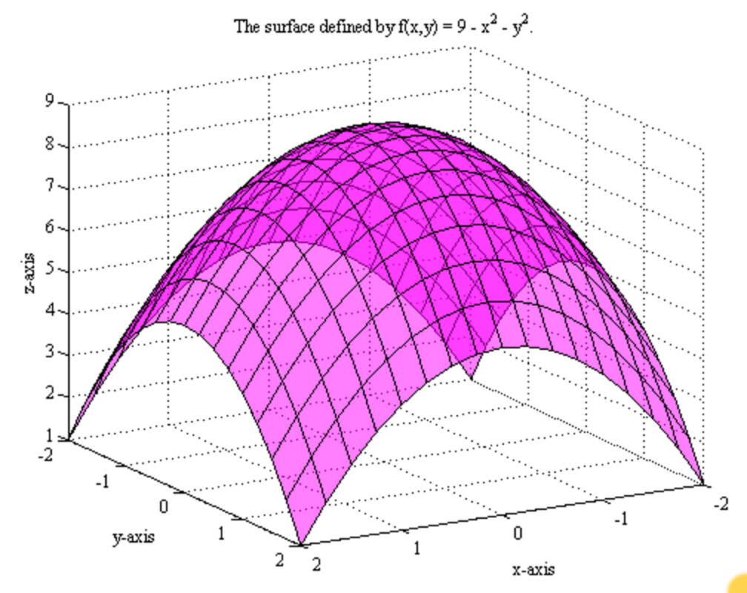
A function of two variables

Slide 6
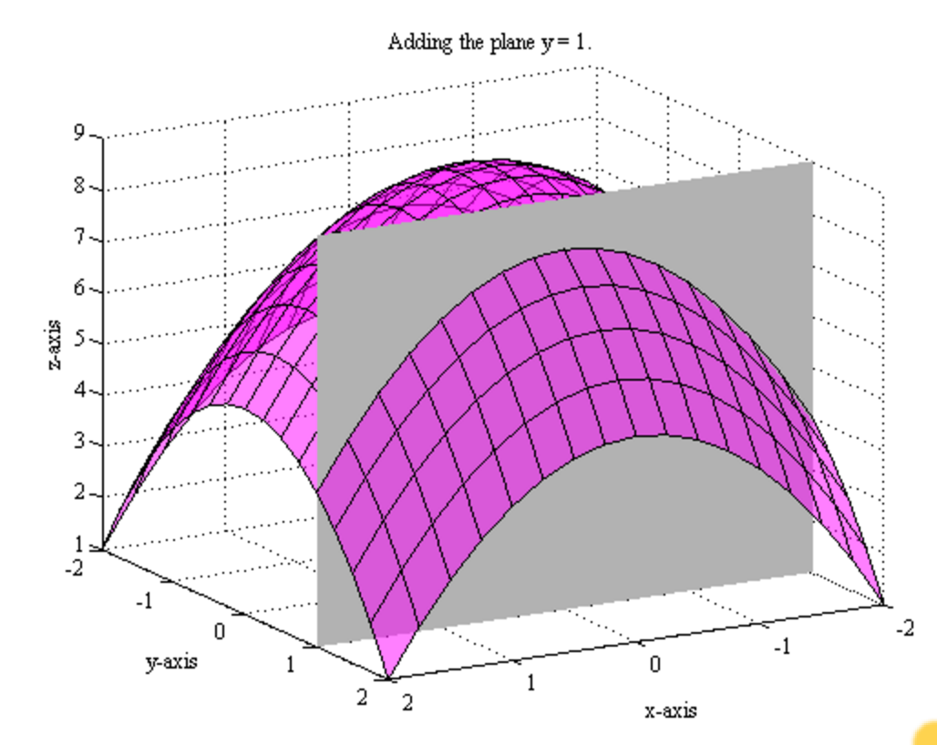
Restricting the function to the variable x

Slide 7
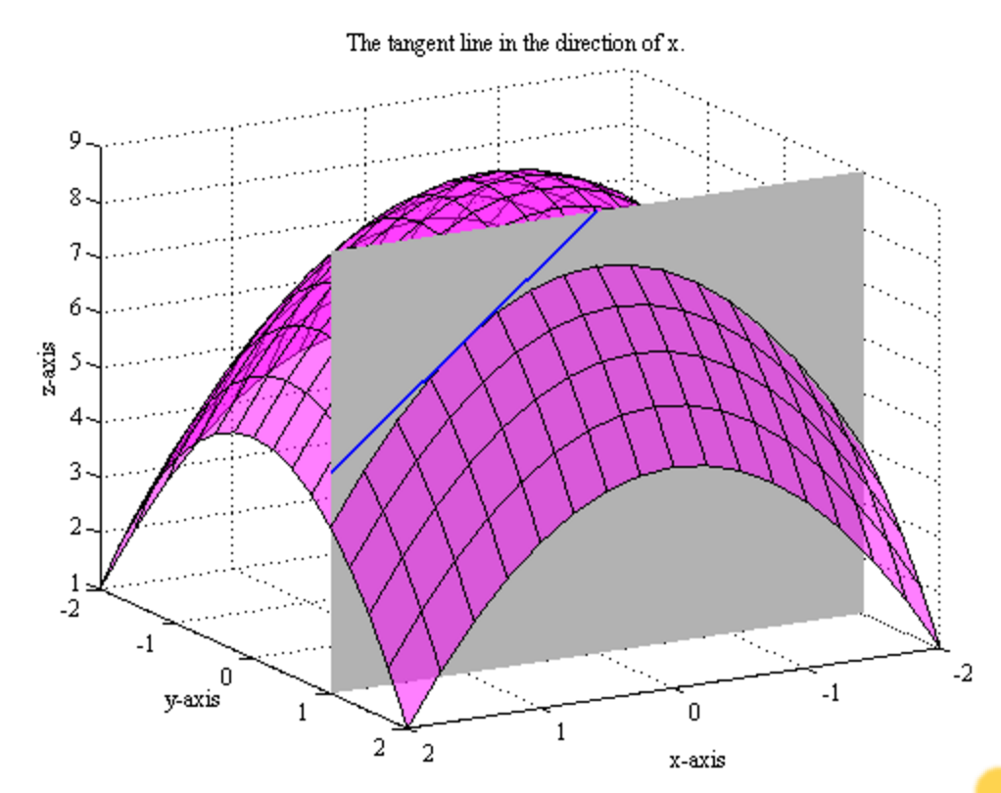
Computing the partial derivative wrt x

Slide 8
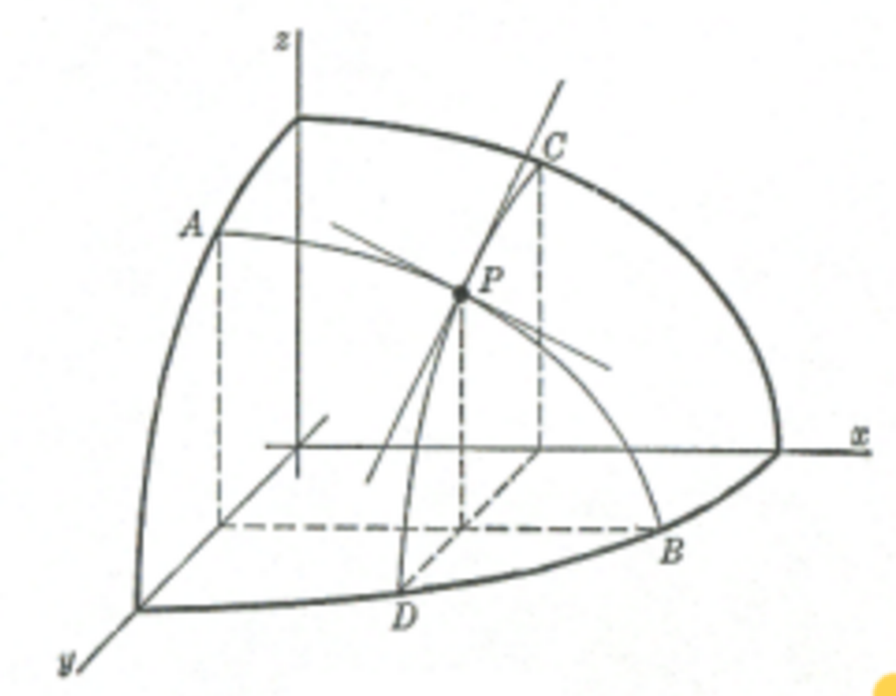
Gradient = the partial derivative wrt all coordinates

Slide 9
Computing the gradient symbolically

Slide 10
Exactly minimizing square error

Slide 11
When the number of examples is large
The size of the matrix A is number of variables X number of examples
Exact solution is not practical.
The alternative: stochastic gradient descent.

Slide 12
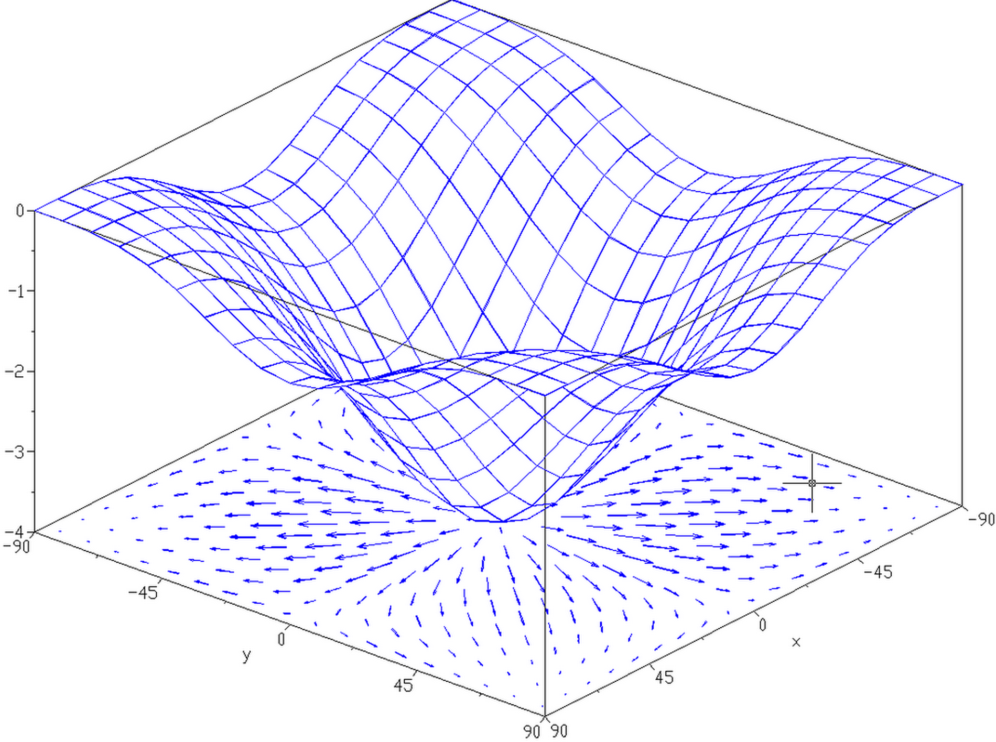
Review: the gradient

Slide 13
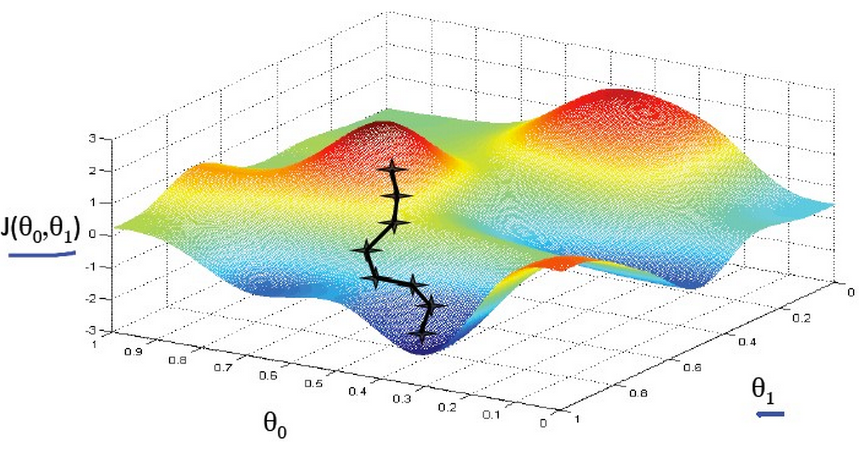
Optimization by Gradient Ascent
Start at a randomly chosen starting point
Take a small step in the direction of the gradient
Repeat
Converges to a local maximum (gradient zero).
Which local maximum depends on starting point
global
Maximum
Local
Maximum
Starting
point

Slide 14
Deterministic & Stochastic Gradient Descent
Taking a step in direction opposite of gradient moves x towards the minimum.
Deterministic gradient Descent: sum over all examples and then take a step.
Stochastic Gradient Descent: take a small step after each example.
Mini-Batch: Take a step after summing M>1 examples.

Slide 15
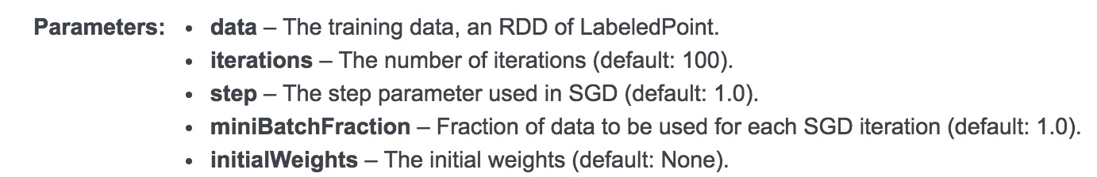
LinearRegressionWithSGD
LinearRegressionWithSGD(data,it,s,miniB,init)

Slide 16
Learning rate and initial weights
SGD is guaranteed to converge to a local minimum, if the learning rate (step) is sufficiently small.
If step size too large – SGD can diverge.
If step size too small – convergence will take many iterations.
Initial weights can help start the process close to the minimum.

Slide 17
Why Minibatch?
Updating separately in each executor will cause the estimate of x for different partitions to diverge.
Alternatively, communicating each update to all executors creates a communication and synchronization bottleneck.
Minibatch: each partition calculates a sum using a fraction of it’s partition. The sums are combined and all executors receive the same updated x
Smaller mini-batches – faster convergence, but more communication.

Slide 18
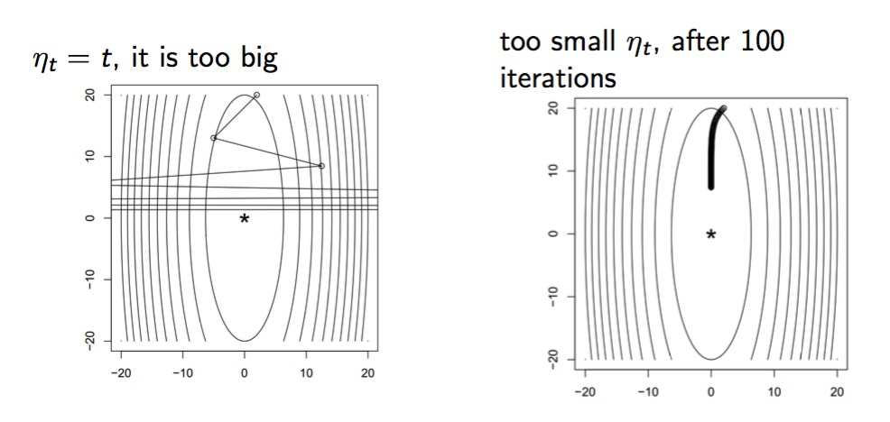
Learning rate matters!

Slide 19
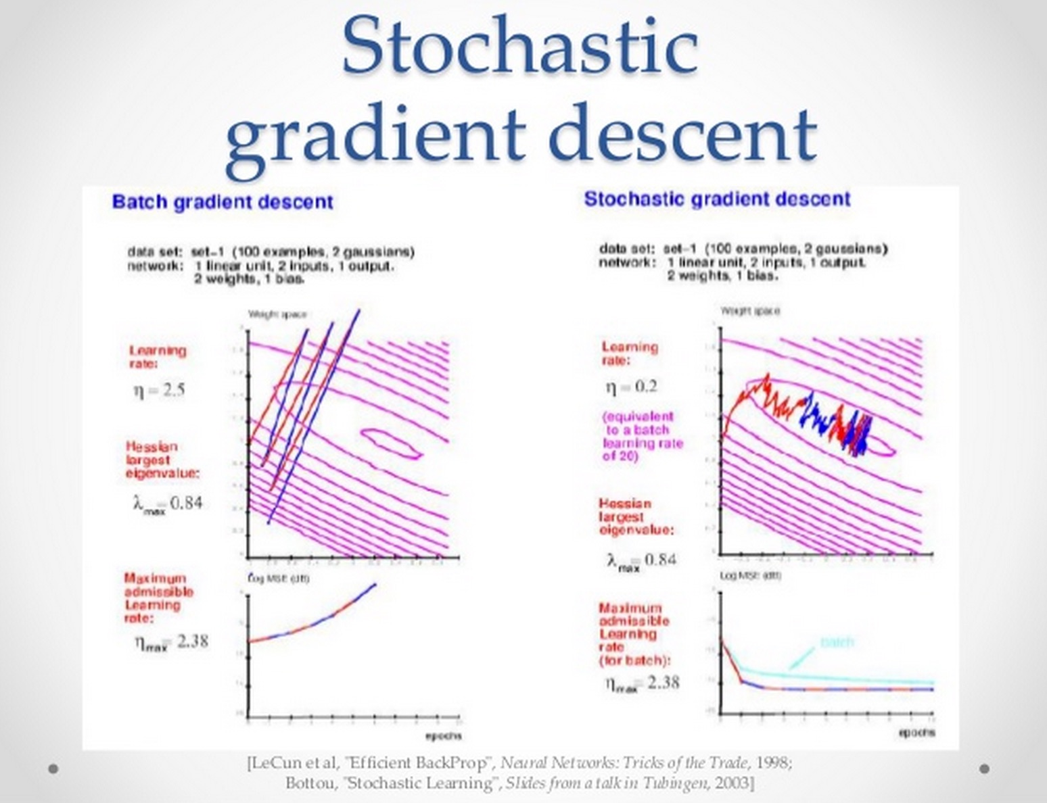

Slide 20
Training set and Test set
We are usually interested in finding models that fit well unseen data.
To evaluate the effectiveness of the learning algorithm we separate the data randomly into two parts:
Training set: used to find best model
Test set: used to see if model generalizes well.

Slide 21
Regularization
When the data is high dimensional and noisy, decreasing the training error too much will often cause the test error to increase.
This is called overfitting.
One way to avoid overfitting is to “regularize” the trained model.

Slide 22
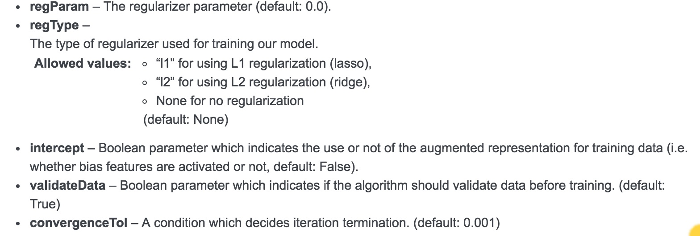
Additional Parameters for
LinearRegressionWithSGD

